Slide 1

Turning Climate Data into Clear Insights
This presentation uses simple, transparent analysis to uncover patterns, extremes, and realistic expectations from historical climate data.
By Ahmed Alimi Data analyst

Slide 2
The Approach Taken
1. Understanding the Data
-Reviewed the dataset structure and time coverage
-Identified key variables (temperature, rainfall, sunshine, frost)
-Noted missing values, estimated data, and measurement differences
2. Data Cleaning & Analysis
-Checked data quality and consistency
-Handled missing and estimated values transparently
-Summarized data to establish baseline behavior
-Used visuals to identify patterns and trends
3. Derive Trends & Insights
-Identified seasonal patterns and long-term trends
-Explored variability and extreme values using visuals
4. Draw Conclusions & Implications
-Combined findings into clear messages
-Explained what the results mean and their limitations
-Provided realistic expectations for future behavior

Slide 3
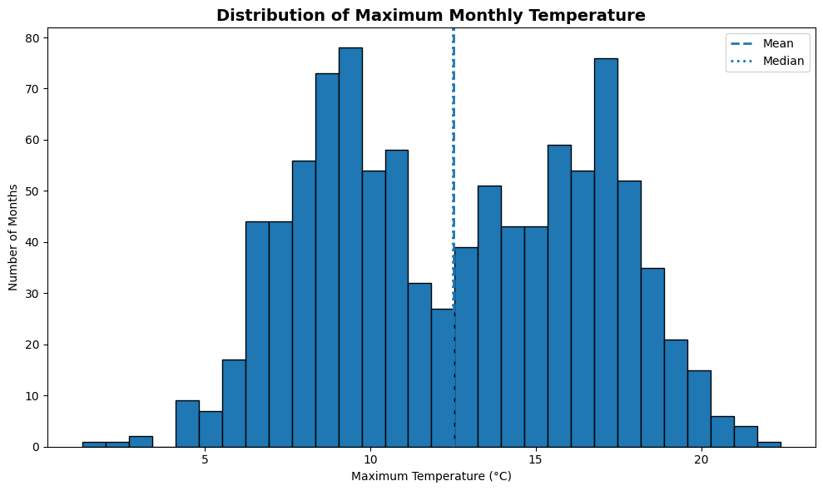
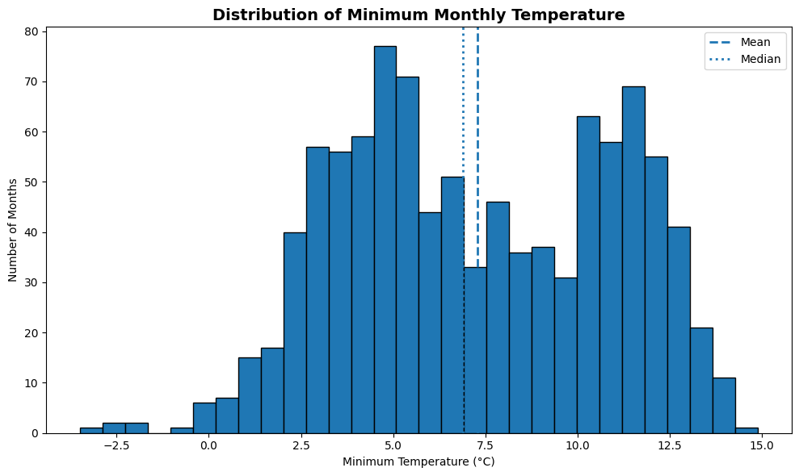
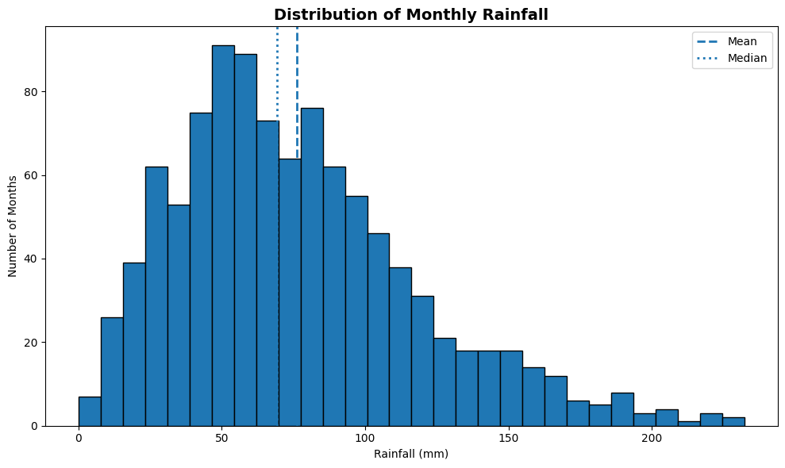
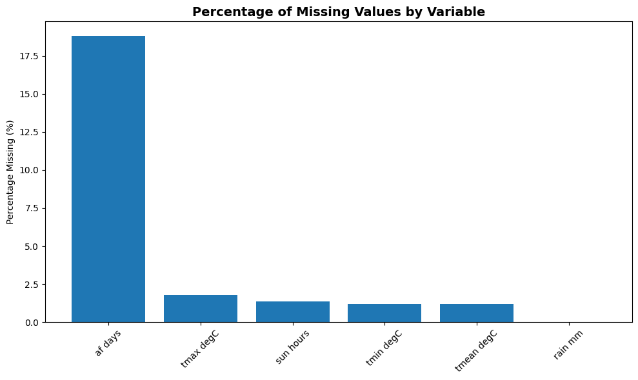
Understanding the Data
Following the CRISP-DM framework, the first analytical step was data understanding.
Data Completeness & Quality
Most variables are highly complete
Air frost days contain the highest proportion of missing values
Rainfall data is fully complete
Estimated values are minimal and mainly affect sunshine hours
Dataset Overview
The dataset consists of monthly climate observations recorded over several decades, structured by year and month, and includes measurements of maximum and minimum temperature, rainfall, sunshine hours, and air frost days, enabling both seasonal and long-term analysis
Distribution of Key Variables
Temperature distributions show clear clustering, reflecting seasonal patterns
Maximum and minimum temperatures display consistent ranges with few extremes
Rainfall distribution is positively skewed, with most months having moderate rainfall and a small number of very wet months

Slide 4
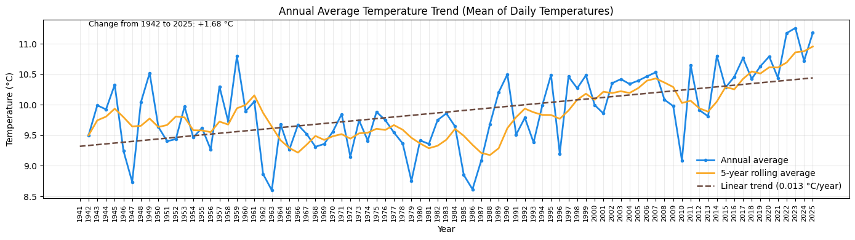
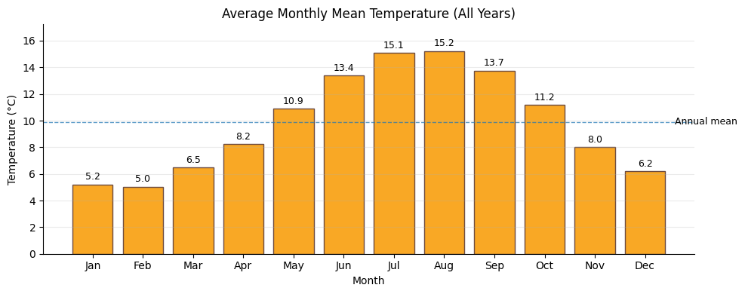
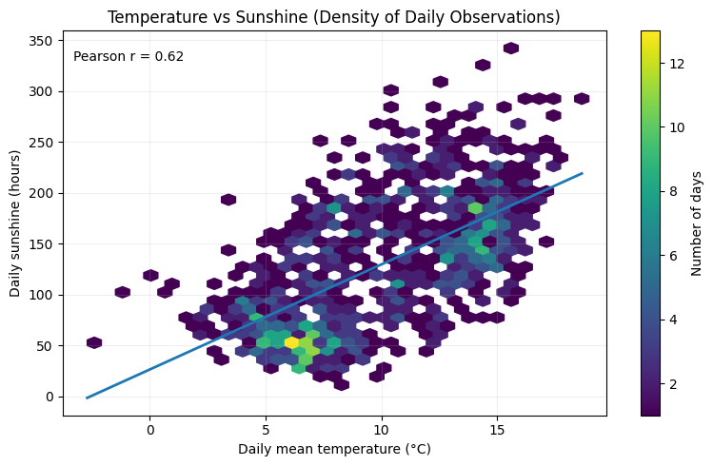
Data Cleaning & Analysis
Data Cleaning & Analysis
The data was cleaned and standardised by addressing missing and estimated values and aligning all records consistently over time to ensure reliable comparisons.
Long-term trends and seasonal patterns were analysed using averages, rolling trends, and monthly summaries, revealing both a clear warming trend and predictable seasonal behaviour.
Key relationships between variables were explored using simple statistical techniques, showing a strong positive link between temperature and sunshine levels.

Slide 5
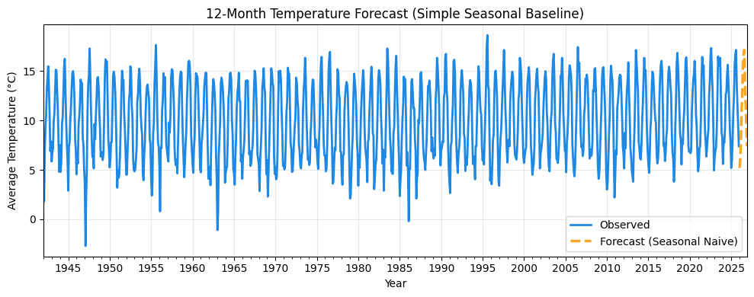
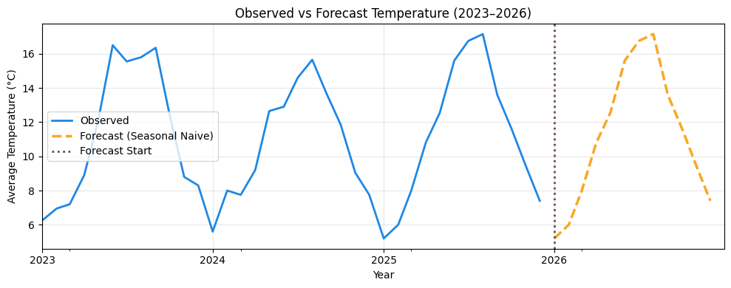
3. Derive Trends & Insights
A clear long-term warming trend is evident, with average temperatures steadily increasing over time beyond normal year-to-year variation.
Seasonal patterns remain consistent, with predictable summer peaks and winter lows repeating across decades.
Temperature is strongly linked to sunshine, reinforcing confidence in the observed climate behaviour and short-term outlook.

Slide 6
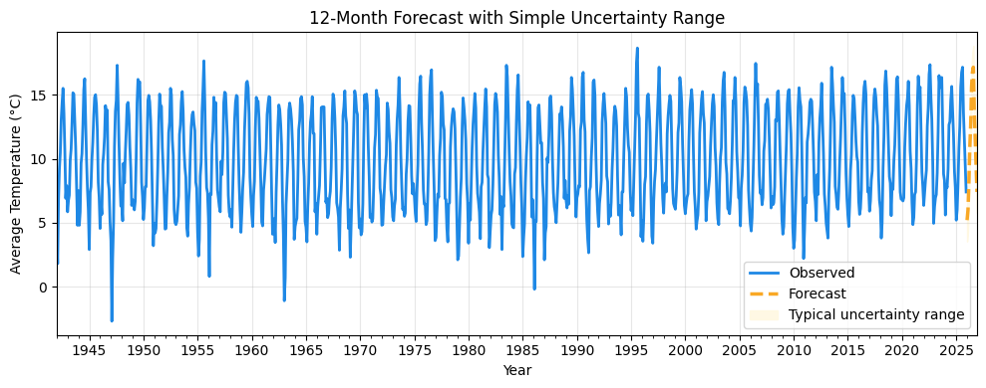
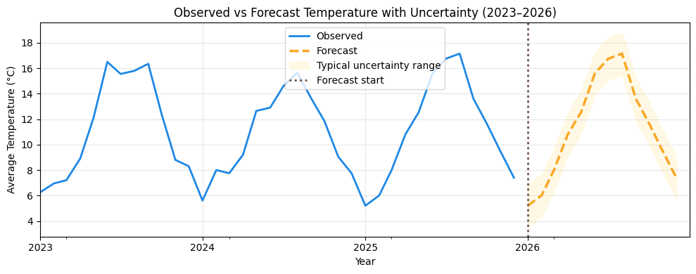
Forecasting & Limitations
A short-term temperature forecast was produced using a seasonal approach, assuming future months follow historical seasonal patterns observed in the data.
An uncertainty range was included to show the typical variation around the forecast, helping to communicate that predictions are approximate rather than exact values.
Forecast confidence decreases over time, as unexpected events and longer-term changes are not captured, so results should be interpreted as indicative trends rather than precise outcomes.

Slide 7

Draw Conclusions & Implications
The analysis shows a clear long-term warming trend, supported by consistent seasonal patterns and strong relationships between temperature and sunshine.
The dataset is largely reliable for trend analysis, with limited missing or estimated values, though some variables require cautious interpretation.
Short-term forecasts suggest continued seasonal behaviour, but results should be used to understand direction rather than exact future values.
Recommendation: Use this analysis to support climate monitoring and planning, while updating forecasts regularly as new data becomes available.

